Slide 1
Chapter 9: 8086/8088 Hardware Specifications

Slide 2
9–1 PIN-OUTS AND THE PIN FUNCTIONS
In this section, we explain the function and
the multiple functions of each of the microprocessor’s pins.
In addition, we discuss the DC characteristics to provide a basis for understanding the later sections on buffering and latching.

Slide 3
The Pin-Out
Figure 9–1 illustrates pin-outs of 8086.
  packaged in 40-pin dual in-line packages (DIPs)
8086 is a 16-bit microprocessor with a 16-bit data bus;
  8086 has pin connections AD₀–AD₁₅
  thus 8086 transfers 16-bit data more efficiently

Slide 4
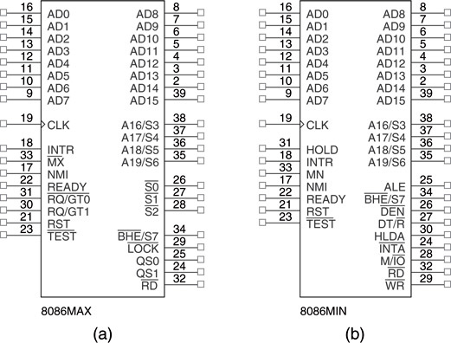
Figure 9–1 (a) The pin-out of the 8086 in maximum mode; (b) the pin-out of the 8086 in minimum mode.

Slide 5
Pin Connections
AD₇ - AD₀

Slide 6
Pin Connections
AD₁₅ - AD₈
8086 address/data bus lines compose upper multiplexed address/data bus on the 8086.
These lines contain address bits A₁₅–A₈ whenever ALE is a logic 1, and data bus connections D₁₅–D₈ when ALE is a logic 0.
These pins enter a high-impedance state when a hold acknowledge occurs.

Slide 7
Pin Connections A₁₉/S₆ - A₁₆/S₃
Address/status bus bits are multiplexed to provide address signals A₁₉–A₁₆ and status bits S₆–S₃.
  status bit S₆ is always logic 0,
  bit S₅ indicates the condition of the IF flag bit
S₄ and S₃ show which segment is accessed during the current bus cycle.
  these status bits can address four separate 1M byte memory banks by decoding as A₂₁ and A₂₀

Slide 8
Pin Connections RD
When read signal is logic 0, the data bus is receptive to data from memory or I/O devices
  pin floats high-impedance state during a hold acknowledge
Ready
Inserts wait states into the timing.
  if placed at a logic 0, the microprocessor enters into wait states and remains idle
  if logic 1, no effect on the operation

Slide 9
Pin Connections INTR
Interrupt request is used to request a hardware interrupt.
  If INTR is held high when IF = 1, 8086/8088
  enters an interrupt acknowledge cycle after the current instruction has completed execution
NMI
The non-maskable interrupt input is similar to INTR.
  does not check IF flag bit for logic 1
  if activated, uses interrupt vector 2

Slide 10
Pin Connections TEST
The Test pin is an input that is tested by the WAIT instruction.
If TEST is a logic 0, the WAIT instruction functions as an NOP.
If TEST is a logic 1, the WAIT instruction
waits for TEST to become a logic 0.
The TEST pin is most often connected to
the 8087 numeric coprocessor.

Slide 11
Pin Connections RESET
Causes the microprocessor to reset itself if held high a minimum of four clocking periods.
  when 8086/8088 is reset, it executes instructions at memory location FFFFOH
  also disables future interrupts by clearing IF flag
CLK
The clock pin provides the basic timing signal.
  must have a duty cycle of 33 % (high for one third of clocking period, low for two thirds) to provide proper internal timing

Slide 12
Pin Connections VCC
This power supply input provides a +5.0 V, ±10 % signal to the microprocessor.
GND
The ground connection is the return for the power supply.
  8086/8088 microprocessors have two pins
  labeled GND—both must be connected to
  ground for proper operation

Slide 13
Pin Connections MN/MX
Minimum/maximum mode pin selects either minimum or maximum mode operation.
  if minimum mode selected, the MN/MX pin must
  be connected directly to +5.0 V
BHE S₇
The bus high enable pin is used in 8086 to enable the most-significant data bus bits
(D₁₅–D₈) during a read or a write operation.
The state of S₇ is always a logic 1.

Slide 14
Minimum Mode Pins
Minimum mode operation is obtained by connecting the MN/MX pin directly to +5.0 V.
  do not connect to +5.0 V through a pull-up register; it will not function correctly
IO/M or M/IO
The IO/M (8088) or M/IO (8086) pin selects memory or I/O.
  indicates the address bus contains either a memory address or an I/O port address.

Slide 15
Minimum Mode Pins WR
Write line indicates 8086/8088 is outputting data to a memory or I/O device.
  during the time WR is a logic 0, the data bus contains valid data for memory or I/O
  high-impedance during a hold acknowledge
INTA
The interrupt acknowledge signal is a response to the INTR input pin.
  normally used to gate the interrupt vector number onto the data bus in response to an interrupt

Slide 16
Minimum Mode Pins ALE
Address latch enable shows the 8086/8088 address/data bus contains an address.
  can be a memory address or an I/O port number
  ALE signal doesn’t float during hold acknowledge
DT/R
The data transmit/receive signal shows that the microprocessor data bus is transmitting (DT/R = 1) or receiving (DT/R = 0) data.
  used to enable external data bus buffers

Slide 17
Minimum Mode Pins DEN
Data bus enable activates external data bus buffers.
HOLD
Hold input requests a direct memory access (DMA).
  if HOLD signal is a logic 1, the microprocessor stops executing software and places address, data, and control bus at high-impedance
  if a logic 0, software executes normally

Slide 18
9–3 BUS BUFFERING AND LATCHING
Before 8086/8088 can be used with memory
or I/O interfaces, their multiplexed buses must be demultiplexed.
This section provides detail required to demultiplex the buses and illustrates how
the buses are buffered for very large systems.
  because the maximum fan-out is 10, the system must be buffered if it contains more than 10 other components

Slide 19
Demultiplexing the Buses
The address/data bus of the 8086/8088 is multiplexed (shared) to reduce the number
of pins required for the integrated circuit
  the hardware designer must extract or
  demultiplex information from these pins
Memory & I/O require the address remain valid and stable throughout a read/write cycle.
If buses are multiplexed, the address changes at the memory and I/O, causing them to read or write data in the wrong locations

Slide 20
All computer systems have three buses:
  an address bus that provides memory and I/O with the memory address or the I/O port number
  a data bus that transfers data between the microprocessor and the memory and I/O
  a control bus that provides control signals to
  the memory and I/O
These buses must be present in order to interface to memory and I/O.

Slide 21
Demultiplexing the 8086
Fig 9–6 illustrates a demultiplexed 8086 with all three buses:
address (A₁₉–A₀ and BHE )
data (D₁₅–D₀),
control (M/IO,RD, and WR )
Here, the memory and I/O system see the 8086 as a device with:
  a 20-bit address bus;16-bit data bus
  and a three-line control bus

Slide 22
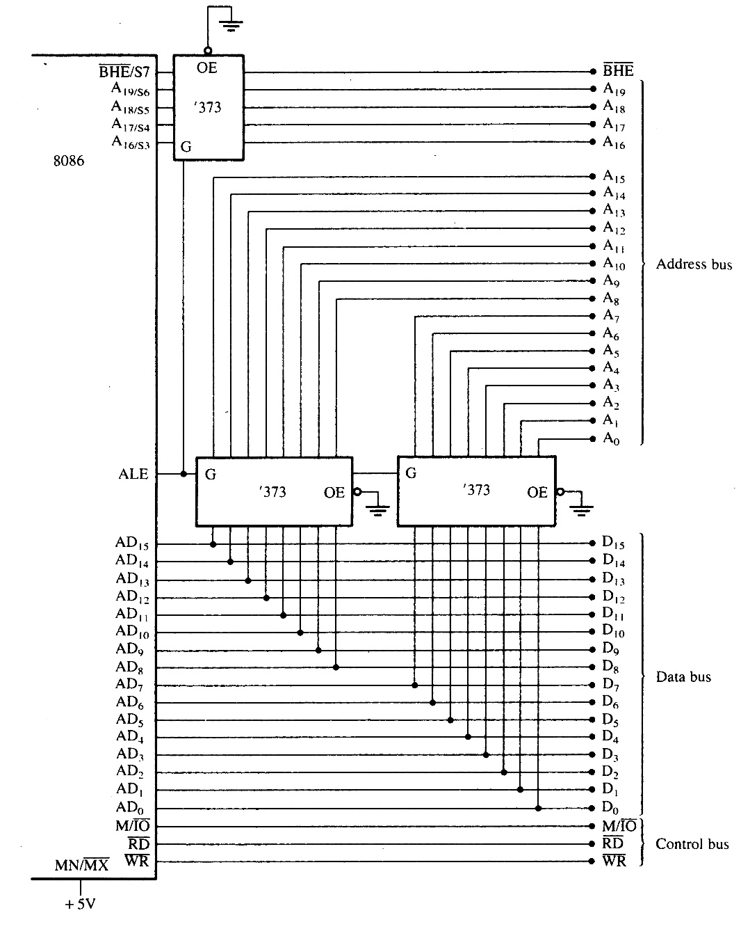
Figure 9–6 The 8086 microprocessor shown with a demultiplexed address bus. This is the model used to build many 8086-based systems.

Slide 23
9–4 BUS TIMING
It is essential to understand system bus timing before choosing memory or I/O devices for interfacing to 8086 or 8088 microprocessors.
This section provides insight into operation
of the bus signals and the basic read/write timing of the 8086/8088.

Slide 24
Basic Bus Operation
The three buses of 8086 function the same way as any other microprocessor.
If data are read from the memory the microprocessor:
  outputs the memory address on the address bus
  issues a read memory signal (RD)
  and accepts the data via the data bus

Slide 25
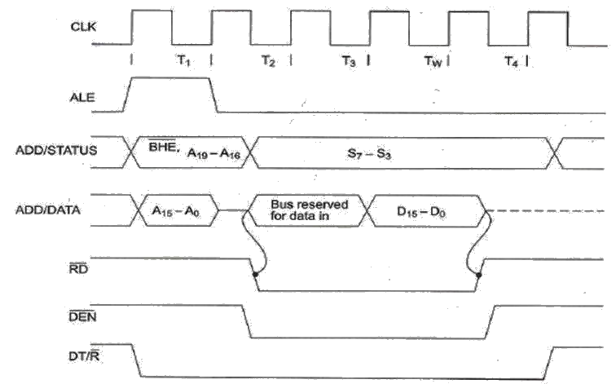
Simplified 8086/8088 read bus cycle.

Slide 26
Basic Bus Operation
If data are written to memory the processor:
  outputs the memory address on the address bus
  outputs the data to be written on the data bus
  issues a write (WR) to memory
  and IO/M = 1 for 8086

